Slide 1
Geek Squad Home Membership
Digital Experience & Usability

Slide 2
AGENDA
1
2
3
4
Intro
Service UX Themes
Sprint Test
Next Steps
Notes:
Business goals
Ux goals and kpi
Form conversion (compared to baseline)
Awareness & Credibility
increase in continent dedicated to initiatives
Lead generation
hypothesis: a lead form is better than the mail to link
Account manager support
Shareable content: leverage 3rd party endorsement
Website organization
Analyze current traffic
In and out traffic, highly related search
Mobile heavy
Search terms correlate with popular searches
Hypothesis: mistap
Next steps
Add tracking code to current page
begin google expedition page
Add web form
A/B test mail link vs form
Discuss
Create edu page
Merchandizing and product driven
Todo
Make presentation
finish analytics
Education page: add featured google analytics
Home page new slide
Move global footer to last push

Slide 3
SERVICE UX THEMES
Key questions for user test
Where should we place GSHM banners through the purchase flow?
Do users notice the GS service during their purchase flow? Are users most likely to notice it on category page, PDP, or cart? Where do they prefer to see it?
Do users understand the GSHM offering? What are their expectations around this service?
Do they have enough information in order to decide if they would like to sign up?

Slide 4
SERVICE UX THEMES
What and how we tested
We invited 5 participants (2 externals, 3 internals) to Best Buy office on May 12th, for 60 minute, 1-on-1, in-person sessions.
Method: semi-structured interview scenario based testing.
Stimulus: online prototype
Scenarios: buying a laptop, looking for help setting up a laptop
Limitations: we only tested scenarios around laptop buying setting-up. For other scenarios or products results may have been different. Due to last minute cancellations from external participants, we interviewed 3 internal participants

Slide 5
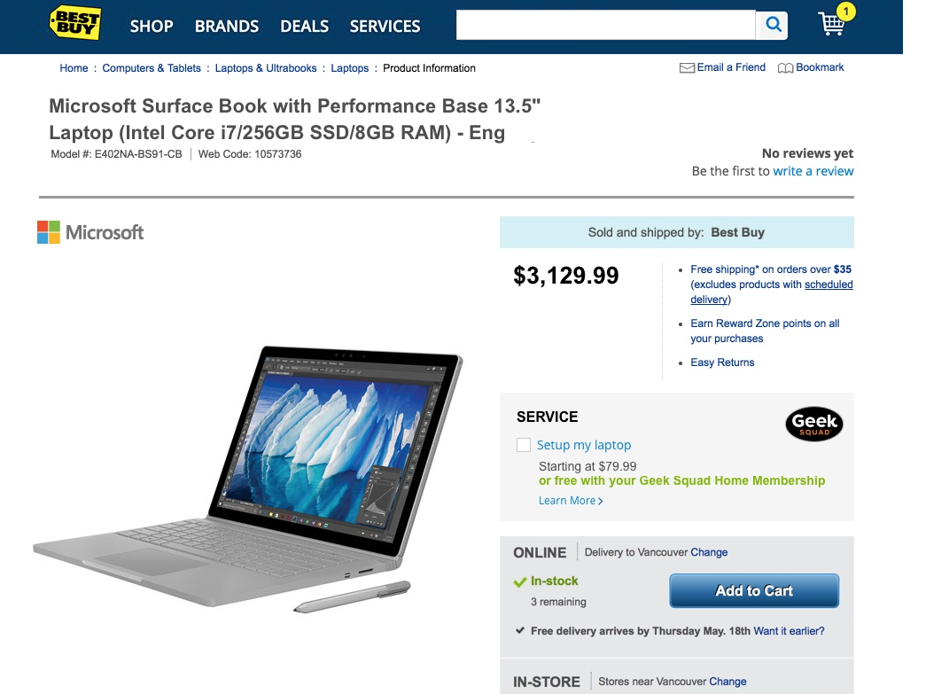
Do users notice the GS service during purchase?

Slide 6
Do users notice the GS service during their purchase flow?
When buying a laptop users looked for price, features and specs (some had trouble finding the specs), and shipping/store information.
Users did not notice GS during their purchase flow for the scenario tested (even though some of them were familiar with the GS program). One user noticed it in cart.
Set-up help when buying a laptop did not provide enough value for them, as most set up their computer by themselves.
Set up is a vague term, different users understand it differently, but they typically think of the basic set-up, and do not think of all the services included in GS set-up.
It is more likely for users to look for help when they have a problem with the computer

Slide 7
Recommendations – where to place GSHM?
Present GS offering later in the flow (cart) and post-purchase
Make GSHM more noticeable to draw attention to it
Present other benefits of GSHM (e.g., tech support, virus removal, what set-up really includes)
Inform users that they can subscribe any time (as some users were not clear if they can do that)
Note: although it would be valuable to explain all benefits, including support after purchase, the message needs to be very concise if presented during purchase flow.

Slide 8
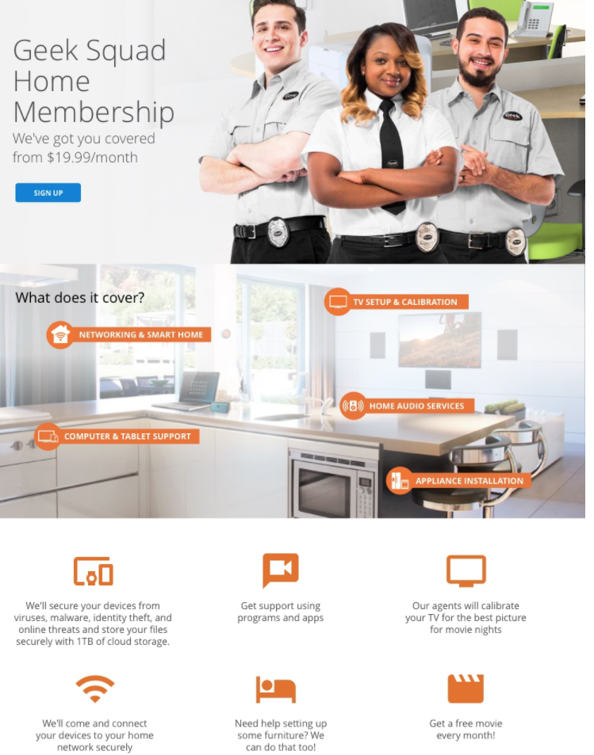
Do users understand the GSHM offering?

Slide 9
Do users understand the GSHM offering?
Users were directed to GSHM page, as there was not enough incentive for them to click on the links to more information (in terms of value proposition and/or visual presentation)
Once they read the benefits, they were positive about the offering, and they liked the all-inclusive nature of the offering.
However users needed for more information about the service as they had many questions even after reading the GSHM page:
What is actually included, when they can become members, is GSMH tied to specific products or purchases?
Users did not know what services to expect for other devices they own, furniture installation.
“ Tell me it’s Included, regardless of purchase time or source”

Slide 10
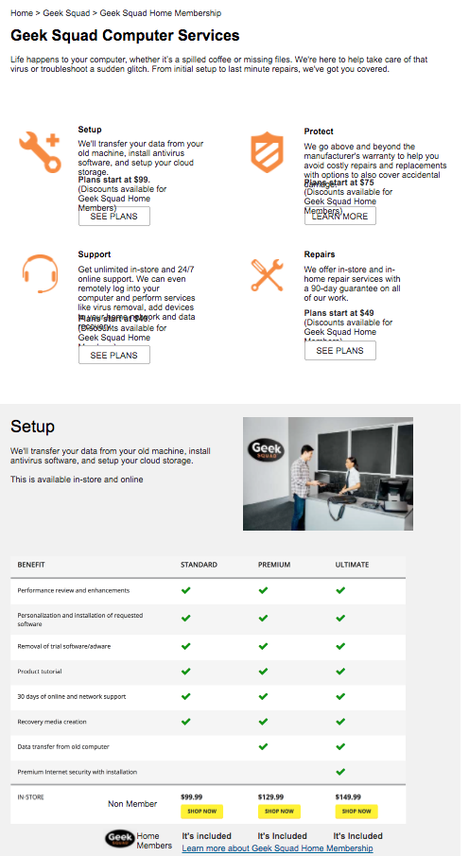
Do users understand the GSHM offering?
Confusion around GSHM and other GS services
Once they saw the computer specific GSHM page, users got confused. They had more questions about the pricing schemes on this page, and additional options presented here (e.g., in-home vs. in-store). They wondered if GS and GSHM plans are connected.

Slide 11
Recommendations – understanding GS services
Clearly present all plans, benefits, options and pricing. Users expect a high-level overview (to allow them to compare and decide), with options to get detailed description all options and benefits.
Categorize options based on user needs (rather than internal GS groups)
Consider simplifying the GS offerings.

Slide 12
What are their expectations around this service?
Users expected to be able to get timely help from GS agents through different channels.
Expectations around self-help portal: Since users pay for the service, they expect to get help from GS members in-person, on phone or online, and are less willing to look for self-help resources.

Slide 13
Do they have enough information in order to decide if they would like to sign up?
Although users needed to be guided to find all the information that they needed, most users knew if they would be interested to sign up by the end of the session.

Slide 14
Other findings
Blog page: Some found it too long, too much information. The page as it was presented did not guide users to find out more information about GS services or sign up.
Recommendations: improve layout and content, add a clear CTA
Online vs. in store shopping - most users do both. Shipping duration is important for online shoppers.
Personalized shopping experience – based on shopping habits, value-add suggestions and tips.

Slide 15
NEXT STEPS

Slide 16
SERVICE UX THEMES
Next Steps
Iteration 2: Re-use prototype and perform a quick follow up test. Add more scenarios to test.

Slide 17
THANK YOU

